Slide 1
Tic Tac Toe
Submitted to:- DR.surbjeet singh
Submitted by:- 1.)abhinav (co19302)
2.)abhinav (co19303)
3.)arshit (co19315)

Slide 2
Objective
Our project name is Tic-Tac-Toe game. It is actually a two player game. In this game , there is a board with nxn squares. In our game, it is 3 x 3 squares .The goal of Tic-Tac-Toe is to be one of the players to get three same symbols in a row - horizontally, vertically or diagonally - on a 3 x 3 grid.
The main purpose for opting this as our project is its very innovative and interesting in itself and we get to learn a lot of new methods and different styles of coding .In day to day life we all have played this game with our friends .With this project we want to recreate this wonderful game on screen.

Slide 3
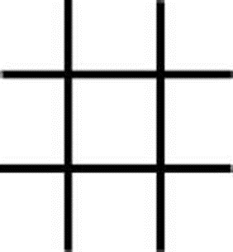
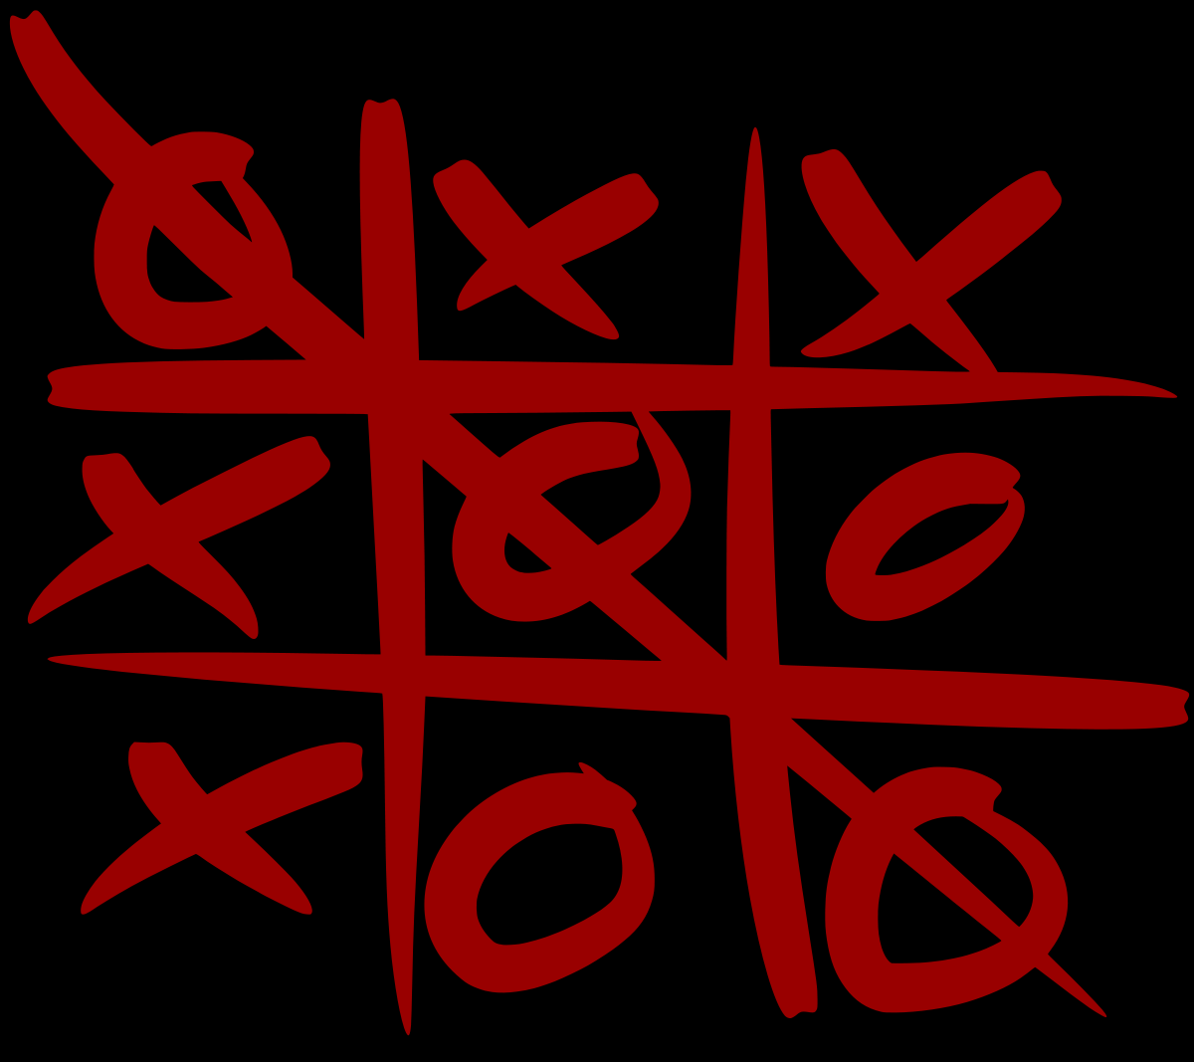
Overview of the Game
This game can be played in a 3x3 grid .The game can be played by two players.
A player can choose between two symbols with his opponent, usual game use “X” and “O”. If first player choose “X” then the second player have to play with “O” and vice versa .A player marks any of the 3x3 squares with his symbol (may be “X” or “O”)and his aim is to create a straight line horizontally or vertically or diagonally with two intensions :a) Create a straight line before his opponent to win the game. b) Restrict his opponent from creating a straight line first .In case logically no one can create a straight line with his own symbol, the game results a tie .Hence there are only three possible results – a player wins, his opponent(human or computer) wins or it’s a tie.

Slide 4
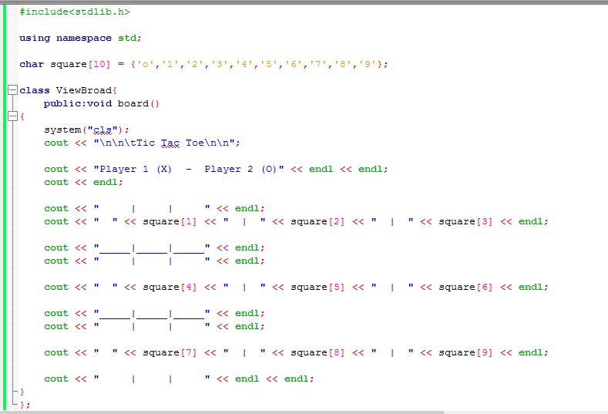
Initialization of code

Slide 5
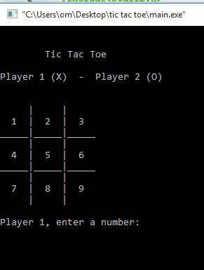
1.) At first in class Viewbroad we declare function public:void broad(). 2.) Then we use system(“cls”) function to clear the existing data on the screen. 3.) Then we write the code to display the 3X3 grid on the screen as shown in picture below from grid 1 to 9.
For Class Viewboard

Slide 6
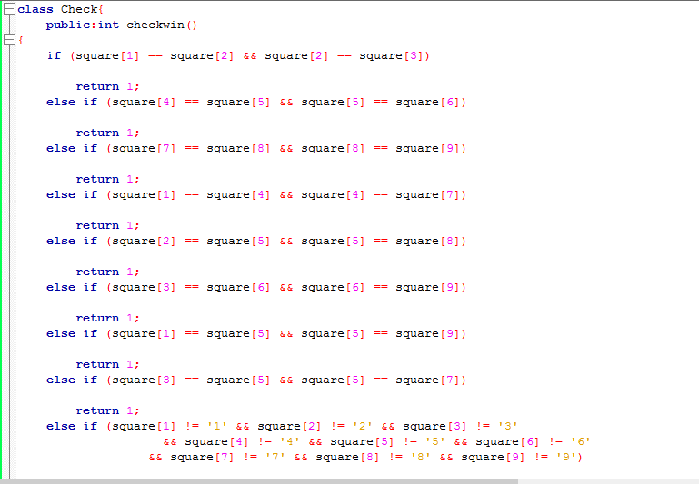


Slide 7
For class Check
This class is used to check the condition for win or draw:-
Condition for win are-(stated in function checkwin())
a) 1, 2, 3
b) 4, 5, 6
c) 7, 8, 9
d) 1, 4, 7
e) 2, 5, 8
f) 3, 6, 9
h) 1, 5, 9
So when ever this condition is achieved it will return 1 else for other combinations it will return 0. If there is an exceptional error then it will return -1,

Slide 8
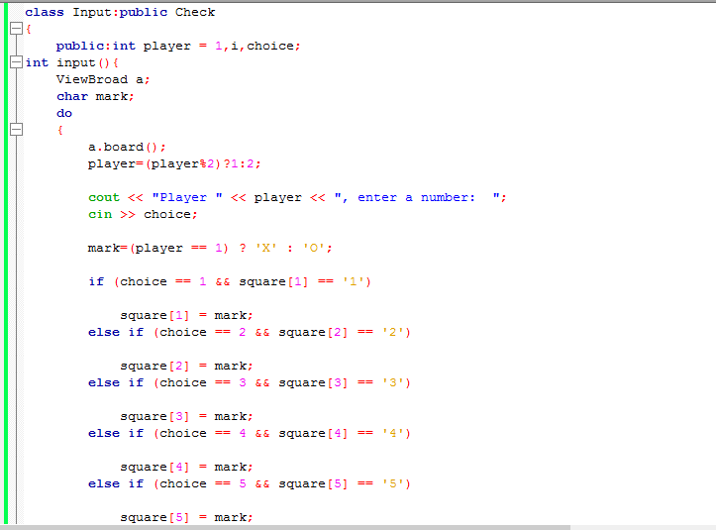
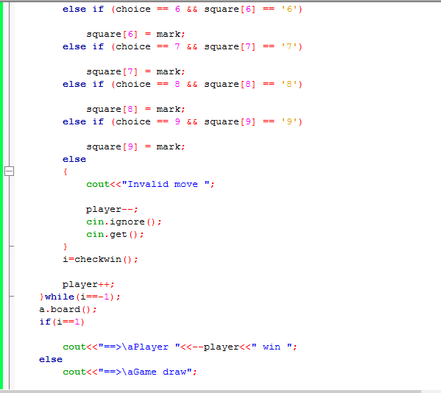
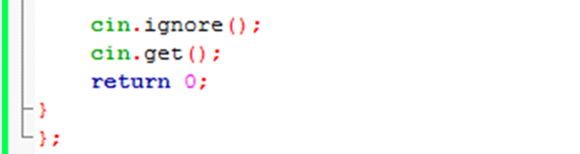

Slide 9
For Class Input
1. In this class we publicly inherit class Check and in input() function we declare the
object of class ViewBroad i.e. a .
2. Then we use the conditional operator do-while.
3. We then nested the another conditional statements { player=(player %2)?1:2 and
mark=(player == 1) ? ‘X’:’O’; } .This will give us the player information and its
selected character.
4. According to the program : if (choice == 1 && square[1] == ‘1’;)
{ square[1] = mark; }
Output : X/O will be printed on the square[1] on the Grid
Similarly we can do the same for all 9 position in the 3X3 grid.
5. For any other exceptional input the output “invalid move” will be displayed on the
screen and the player will get an another chance.
6. Our input in the grid will be checked and the winner will be declared .
7. Else it will be draw.

Slide 10
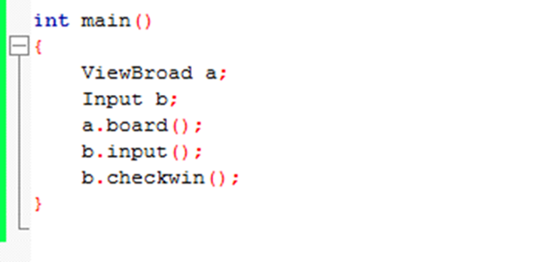
Int main
In the main function we declare the object “a” of the class ViewBroad and object “b” of class Input as shown picture.
Then we we use dot(.) operator :
a.board() // it will call the function board() from class ViewBroad
b.input() // it will call the function input() from class Input
b.checkwin() // it will call the function checkwin() from class Check as class Check is inherited from class Input.

Slide 11
Thank you ….hope you like it

